Slide 1

Operating System (O.S)
Lect-5

Slide 2
Process Management

Slide 3
Process
A process is a program in execution , in different O.s process may called job or Activity
A process is a unit of work in some system
A program in execution is called Process
A process include:
Program counter (to indicate the current activity)
Stack (keep temporary data)
Data Section( global variable)

Slide 4
If you run same application program twice it means you create two process
For Example
If you open two editor in two different windows each editor is a separate process
A C.P.U may shared among many process
Active process May either be waiting to the C.P.U or executing on it
A process which is waiting for the C.P.U is ready and a process which has been allocated to the C.P.U is running

Slide 5
Process States
As the process executes, it changed its states.
Each process may be in one of the following state:
Process States
New
Active
Waiting
Halt
Ready
Running

Slide 6
Process States
New: A process is being created
Active: Active process may either be waiting for the C.P.U or executing on it
Ready: A process which is waiting for the C.P.U
Running: Instruction are being executed
Waiting: A process which is waiting for an event(e.g, I/O)
Halt: A process terminate when interrupt occurs.
Terminate: The process has ﬁnished execution.
New
Active
Halt
Terminated
Waiting

Slide 7
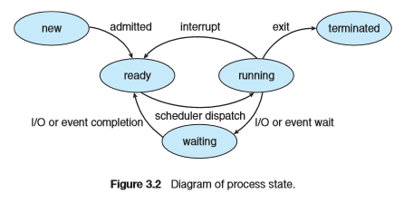
Detail Diagram

Slide 8
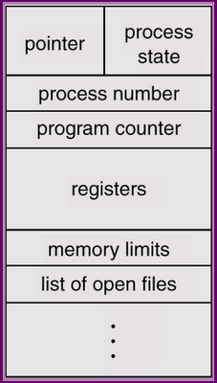
Process control Block(PCB)
Process Control block is used for storing the collection of information about the Processes and this is also called as the Data Structure which Stores the information about the process
Each process is represented in the operating system by a process control block (PCB) also called a task control block.
The information of the Process is used by the CPU at the Run time.
There’s a data structure called the process control block (PCB) that holds all this stuff.
The PCB serves as the repository for any information which can vary from process to process.

Slide 9
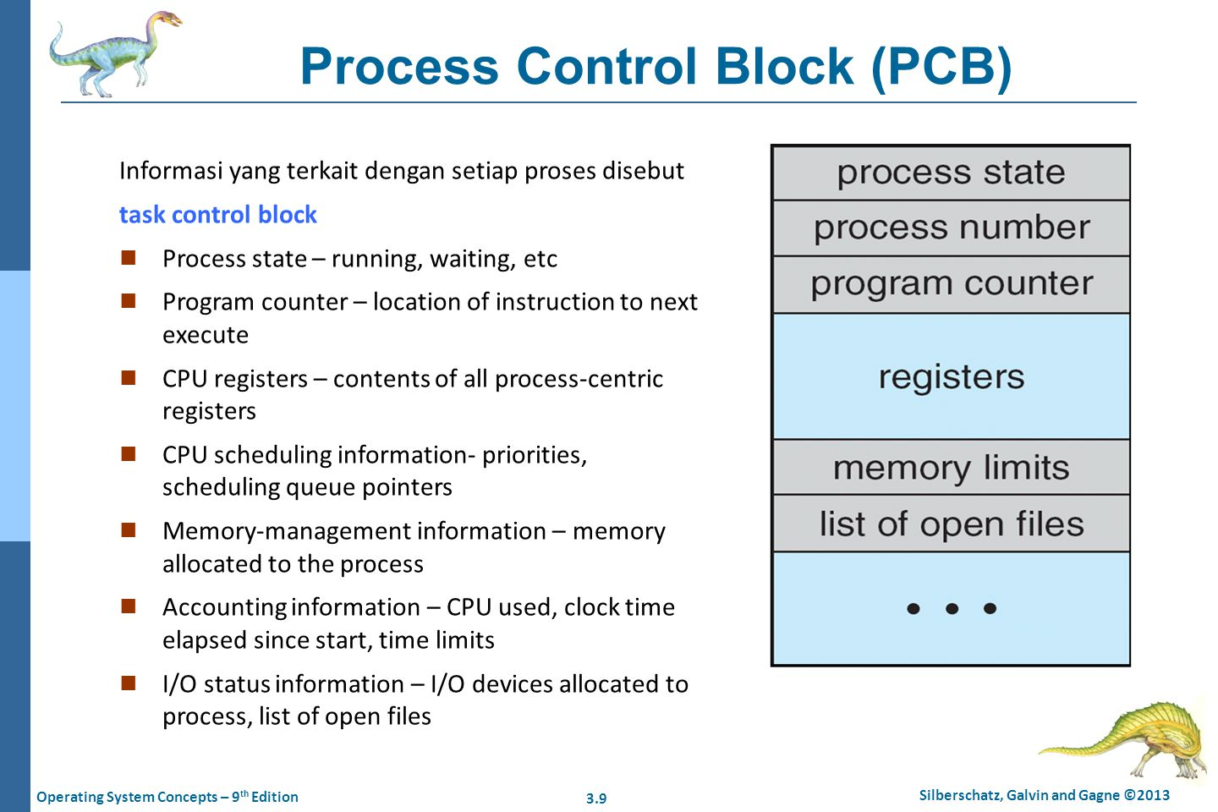
Process control Block(PCB) PCB contains many pieces of information associated with a specific process which are described below.
Pointer points to another process control block. Pointer is used for maintaining the scheduling list.

Slide 10
Role of Process control Block(PCB)
The PCB is identified by an integer process ID (PID)The various information which is Stored into the PCB as followings:
1) Name of the Process.
2) State of the Process. Means Ready, Active, Wait.
3) Resources allocated to the Process
4) Memory which is provided to the Process.
5) Scheduling information.
6) Input and Output Devices used by the Process.
7) Process ID or a Identification Number which is given by the CPU when a Process Request for a Service.

Slide 11
scheduling
The process scheduling is the activity of the process manager that handles the removal of the running process from the CPU and the selection of another process on the basis of a particular strategy.
When more than one process is runnable, the O.S must decide which one first to run
The part of the O.S concerned with the decision is called the Scheduler and algorithm it uses called Scheduling Algorithm.
Any recourses before utilization it must be schedule
Process scheduling is an essential part of a Multiprogramming operating system.
Such operating systems allow more than one process to be loaded into the executable memory at a time and loaded process shares the CPU using time multiplexing.

Slide 12
scheduling
Through Scheduling:
Response Time: Scheduler minimize the response time for users
Turn-around Time: Scheduler minimize the Turn-around time for users
C.P.U Utilization: Scheduler maximize the C.P.U utilization
Throughput: Scheduler maximize the no. of jobs per unit time

Slide 13
Scheduling Ques
Scheduling queues refers to queues of processes or devices.
The operating system also maintains other queues such as device queue.
Device queue is a queue for which multiple processes are waiting for a particular I/O device.
Each device has its own device queue.
When the process enters into the system, then this process is put into a job queue. This queue consists of all processes in the system.
Process in memory, waiting to execute are in the Ready Que
A Ready Header contain pointer to the first and last PCB in the list, each of which has pointer to next PCB.
Device Que: The list of process which are waiting for I/O Devices
After a process in Ready Que is selected for execution
It could be issue an I/O request and put in the I/O Que
It could create a sub-process and wait for its termination
It Could be interrupted and go to the Ready Que.

Slide 14
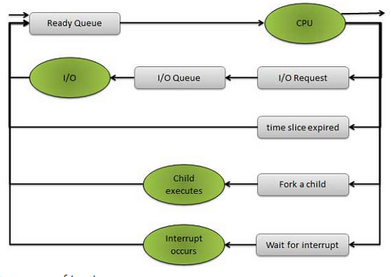
Scheduling Ques This figure shows the queuing diagram of process scheduling.

Slide 15
Types of Scheduling Ques
Scheduling Ques
Job Que
Device Que
Ready Que
Dedicated Que
Shared Que

Slide 16
Types of Scheduling Ques
Job Que:
When the process enters into the system, then this process is put into a job queue. This queue consists of all processes in the system.
Ready Que:
The process that are residing in main memory and wait for C.P.U are kept in list called Ready Que
Ready Que are implemented by link list, FIFO Que, Priority Que, Tree, Stack etc.
Device Que:
The process that are waiting for Device to become availaible or to deliver data are placed in device Que

Slide 17
Process Scheduling
The act of determining which process in the ready state should be moved to the running state is known as Process Scheduling.
The prime aim of the process scheduling system is to keep the CPU busy all the time and to deliver minimum response time for all programs. For achieving this, the scheduler must apply appropriate rules for swapping processes IN and OUT of CPU.
Schedulers fell into one of the two general categories :
Non pre-emptive scheduling. When the currently executing process gives up the CPU voluntarily.
Pre-emptive scheduling. When the operating system decides to favour another process, pre-empting the currently executing process.

Slide 18
Scheduler:
A process migrate between the various scheduling Ques throughout its Lifetime
Scheduler select process from these Ques
Their main task is to select the jobs to be submitted into the system and to decide which process to run .
Types of Scheduler
Long-Term scheduler
Short-Term scheduler
Medium-Term scheduler

Slide 19
Long-term scheduler/Job Scheduler:
It is also called job scheduler.
Long term scheduler determines which programs are admitted to the system for processing.
Select process from pool and load them into memory for execution.
The primary objective of the job scheduler is to provide a balanced mix of jobs, such as I/O bound and processor bound.
It also controls the degree of multiprogramming.
If the degree of multiprogramming is stable, then the average rate of process creation must be equal to the average departure rate of processes leaving the system.
I/O Bound Process: Spend more time for doing I/O than computation
C.P.U Bound Process: Spend more time for doing Computation

Slide 20
Short-term scheduler/C.P.U Scheduler:
It is also called CPU scheduler.
Main objective is increasing system performance in accordance with the chosen set of criteria.
It is the change of ready state to running state of the process.
CPU scheduler selects process among the processes that are ready to execute and allocates CPU for it.
Short term scheduler also known as dispatcher, execute most frequently and makes the fine grained decision of which process to execute next.
Short term scheduler is faster than long term scheduler.

Slide 21
Medium-term scheduler/C.P.U Scheduler:
Medium term scheduling is part of the swapping.
It removes the processes from the memory.
It reduces the degree of multiprogramming.
The medium term scheduler is in-charge of handling the swapped out-processes.
Running process may become suspended if it makes an I/O request.
Suspended processes cannot make any progress towards completion.
In this condition, to remove the process from memory and make space for other process, the suspended process is moved to the secondary storage
This process is called swapping, and the process is said to be swapped out or rolled out.
Swapping may be necessary to improve the process mix.

Slide 22
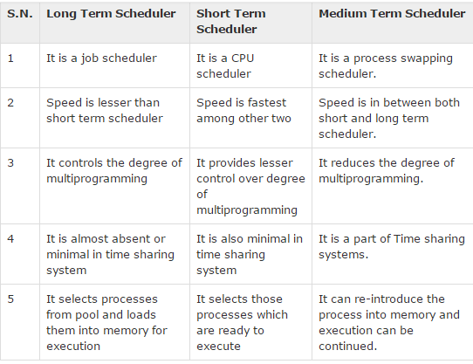
Comparison between Scheduler

Slide 23
Context Switch
Interrupts cause the operating system to change a CPU from its current task and to run a kernel routine.
When an interrupt occurs, the system needs to save the current context of the process running on the CPU so that it can restore that context when its processing is done
It essentially suspending the process and then resuming it.
The context is represented in the PCB of the process.
It includes the value of the CPU registers, the process state, and memory-management information.
Generically, we perform a state save of the current state of the CPU, be it in kernel or user mode, and then a state restore to resume operations.
Switching the CPU to another process requires performing a state save of thecurrentprocessandastaterestoreofadifferentprocess.Thistaskisknown as a context switch

Slide 24
When a context switch occurs, the kernel saves the context of the old process in its PCB and loads the saved context of the new process scheduled to run.
Context-switch time is pure overhead, because the system does not useful work while switching.
Switching speed varies from machine to machine, depending on the memory speed, the number of registers.

